Slide 1
Electronics Practical
S.Y.B.Sc. (C.S.)Sem IV
Group A
Sharmishtha B Sumbe
Nowrosjee Wadia college

Slide 2
Introduction to Raspberry Pi Interfacing Programming

Slide 3
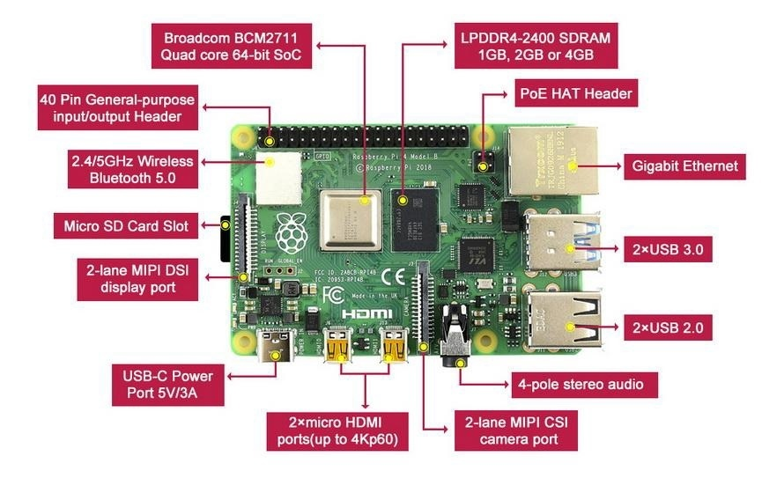
Raspberry pi (board) image

Slide 4
40 Pin GPIO header (Pin function)
Raspberry Pi model has 40 GPIO header pins. Out of these 40 GPIO header pins
2 are power pins of 3.3V
2 are power pins of 5V
8 are ground pins (GND)
28 are general purpose pins (few are purely general purpose and few have dual functions or reserved)
The pins are physically numbered 1-40, but also have GPIO numbers.

Slide 5
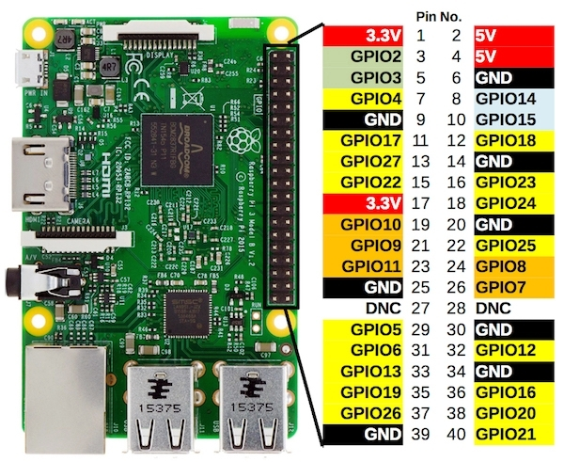
Pin out diagram (40 Pin) GPIO header

Slide 6
I/O function (GPIO, Digital)
GPIO:
General Purpose Input Output (GPIO)pins of raspberry pi can be used as input or output . Through the GPIO pins Raspberry Pi can connect to outside world and access input and output.
GPIO pins of Raspberry Pi are the physical interface between Pi and the outside world.
GPOI pins can be programmed according to user’s need to interact with external devices.
For example:- To read the state of a physical switch, any GPIO pin can be configured as input pin and read the switch status to make the decision.

Slide 7
To use Raspberry Pi GPIO pins in python, RPi.GPIO package has to be imported. It is already installed on Raspbian OS, hence no need to install externally. Only import this package by writing instruction,
import RPi.GPIO as GPIO
The GPIO pin number and physical pin number of Raspberry Pi are different.
In GPIO numbering , pin number refers to number on Broadcom SoC.
In physical numbering pin number refers to the pin 40-pin header on Raspberry Pi board.
The GPIO pins of the Raspberry Pi has to be defined as:
GPIO.setmode(pin numbering system)

Slide 8
The GPIO pins of the Raspberry Pi has to be defined as:
GPIO.setmode(pin numbering system)
In RPi.GPIO, GPIO numbering is identified by BCM where as physical numbering is identified by BOARD.
i.e. pin numbering system= BOARD/BCM
In GPIO numbering i.e. BCM
GPIO.setmode(GPIO.BCM)
In Physical numbering i.e. BOARD
GPIO.setmode(GPIO.BOARD)

Slide 9
Set the direction of GPIO pin
GPIO.setup(channel, direction, initial value, pull up/pull down)
this function is used to set the direction of GPIO pin as an input /output.
channel: GPIO pin as per numbering system
direction: set direction of GPIO pin as either Input or Output.
initial value: can provide initial value
pull up/pull down: enable pull up or pull down if required

Slide 10
Implimentation of GPIO.setup function
#GPIO as Output
GPIO.setup(channel,GPIO.OUT)
#GPIO as Input
GPIO.setup(channel,GPIO.IN)
#GPIO as Output with initial value
GPIO.setup(channel,GPIO.OUT, initial=GPIO.HIGH)
#GPIO as Input with pull up resistor
GPIO.setup(channel,GPIO.IN,pull_up_down=GPIO.PUD_UP)

Slide 11
For example :- If user is using pin 40 as a GPIO pin then it will be configured as
In GPIO numbering i.e. BCM
GPIO.setmode(GPIO.BCM)
GPIO.setup(21,GPIO.OUT)
In Physical numbering i.e. BOARD
GPIO.setmode(GPIO.BOARD)
GPIO.setup(40,GPIO.OUT)

Slide 12
GPIO.output and GPIO.input
GPIO.output(channel,state)
This function is used to set output state of GPIO pin.
Channel: GPIO pin number as per numbering system.
State: output state i.e.HIGH or LOW of GPIO pin.
E.g. GPIO.output(7,GPIO.HIGH)
Means pin 7 is set as output pin and output state is HIGH
GPIO.input(channel)
This function is used to read the value of GPIO pin.
Channel: GPIO pin number as per numbering system.
E.g. GPIO.input(9)
Means pin 9 set as an input pin

Slide 13
Time functions
All the programming languages have date and time functions.
The epoch :
In python beginning of time started measuring from 1st January, 12:00 am, 1970 UTC and this very time is termed as “epoch”. The ‘epoch ’ is the starting point against which you can measure the passage of time, where the time starts.
For example: Midnight of 2nd January 1970 can be represented by 86400 seconds since the epoch
Python consists of a function named ‘time’ to handle time related tasks. For this first the time module has to be imported by using instruction
Import time
There are several different time functions are present e.g. time.ctime() , time.sleep() etc.

Slide 14
time.sleep() function
The time.sleep(): The time.sleep() function pause the current execution for specified number of seconds . It passes a floating point value as input to get more precise sleep time.
This function can be used by the user where he need to wait for a file to finish closing.
For example
import time
# wait for 5 seconds
time.sleep(5)
# wait for 300milli seconds
#.3 can also be used
time.sleep(.300)

